Slide 1



Lumio English
LESSON
9
MY HOUSE
house • bedroom • kitchen • bathroom • living room • door • window
LEVEL 1 · 7 NEW WORDS
Notes:
Welcome the class. Today: My House. Goal: I can name rooms in my house..

Slide 2



Lumio English
Welcome to Lumio English
2 / 27
Hello, little star!
Teacher says:
"Hello! Today we learn 7 new words!"
Notes:
Warm greeting. Set a positive, energetic tone.

Slide 3


Lumio English
Today's Goals
3 / 27
By the end, you will:
1. Say 7 new words
2. I can name rooms in my house.
3. Play games and earn stars
Notes:
Read goals aloud. Keep energy up.

Slide 4


Lumio English
Warm-up • My House
4 / 27
Let's get ready!
Stand up and stretch!
Say hello to a friend.
Clap your hands three times!
Notes:
2-3 minutes, high energy, physical movement.

Slide 5

Lumio English
Words for Today
5 / 27
7 new words
house — منزل
bedroom — غرفة النوم
kitchen — المطبخ
bathroom — الحمام
living room — غرفة المعيشة
door — باب
window — نافذة
Notes:
Preview words quickly. Don't teach yet, just build excitement.

Slide 6

Lumio English
Vocabulary • house
6 / 27
house
منزل
SAY IT
"This is my house."
Listen → Repeat ×3
Notes:
Model "house" x2, choral repeat x3. Meaning: منزل. Sentence: This is my house..

Slide 7


Lumio English
Practice • house
7 / 27
Can you say it?
"This is my house."
منزل
Notes:
Call on a student. Give first-sound hint if needed: "h..."

Slide 8


Lumio English
Vocabulary • bedroom
8 / 27
bedroom
غرفة النوم
SAY IT
"This is my bedroom."
Listen → Repeat ×3
Notes:
Model "bedroom" x2, choral repeat x3. Meaning: غرفة النوم. Sentence: This is my bedroom..

Slide 9
Lumio English
Practice • bedroom
9 / 27
Can you say it?
"This is my bedroom."
غرفة النوم
Notes:
Call on a student. Give first-sound hint if needed: "b..."

Slide 10


Lumio English
Vocabulary • kitchen
10 / 27
kitchen
المطبخ
SAY IT
"This is the kitchen."
Listen → Repeat ×3
Notes:
Model "kitchen" x2, choral repeat x3. Meaning: المطبخ. Sentence: This is the kitchen..

Slide 11
Lumio English
Practice • kitchen
11 / 27
Can you say it?
"This is the kitchen."
المطبخ
Notes:
Call on a student. Give first-sound hint if needed: "k..."

Slide 12
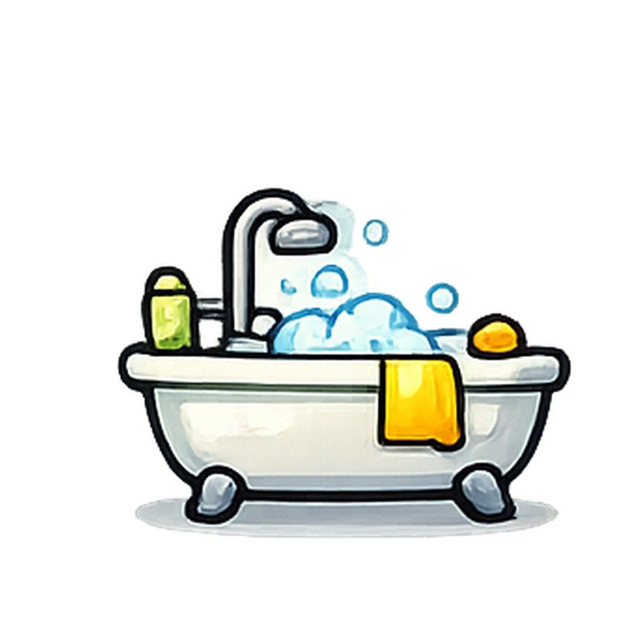
Lumio English
Vocabulary • bathroom
12 / 27
bathroom
الحمام
SAY IT
"This is the bathroom."
Listen → Repeat ×3
Notes:
Model "bathroom" x2, choral repeat x3. Meaning: الحمام. Sentence: This is the bathroom..

Slide 13
Lumio English
Practice • bathroom
13 / 27
Can you say it?
"This is the bathroom."
الحمام
Notes:
Call on a student. Give first-sound hint if needed: "b..."

Slide 14

Lumio English
Vocabulary • living room
14 / 27
living room
غرفة المعيشة
SAY IT
"This is the living room."
Listen → Repeat ×3
Notes:
Model "living room" x2, choral repeat x3. Meaning: غرفة المعيشة. Sentence: This is the living room..

Slide 15
Lumio English
Practice • living room
15 / 27
Can you say it?
"This is the living room."
غرفة المعيشة
Notes:
Call on a student. Give first-sound hint if needed: "l..."

Slide 16

Lumio English
Vocabulary • door
16 / 27
door
باب
SAY IT
"Open the door."
Listen → Repeat ×3
Notes:
Model "door" x2, choral repeat x3. Meaning: باب. Sentence: Open the door..

Slide 17
Lumio English
Practice • door
17 / 27
Can you say it?
"Open the door."
باب
Notes:
Call on a student. Give first-sound hint if needed: "d..."

Slide 18

Lumio English
Vocabulary • window
18 / 27
window
نافذة
SAY IT
"Close the window."
Listen → Repeat ×3
Notes:
Model "window" x2, choral repeat x3. Meaning: نافذة. Sentence: Close the window..

Slide 19
Lumio English
Practice • window
19 / 27
Can you say it?
"Close the window."
نافذة
Notes:
Call on a student. Give first-sound hint if needed: "w..."

Slide 20

Lumio English
Listen and Repeat
20 / 27
My turn, your turn!
1. house
2. bedroom
3. kitchen
4. bathroom
5. living room
6. door
7. window
Notes:
Point and say each word, students repeat.

Slide 21

Lumio English
Your Turn • Round 1 of 3
21 / 27
What is this?
Notes:
Call a student by name. Answer: house (منزل). Hint if needed: "h..."

Slide 22
Lumio English
Your Turn • Round 2 of 3
22 / 27
What is this?
Notes:
Call a student by name. Answer: bedroom (غرفة النوم). Hint if needed: "b..."

Slide 23
Lumio English
Your Turn • Round 3 of 3
23 / 27
What is this?
Notes:
Call a student by name. Answer: kitchen (المطبخ). Hint if needed: "k..."

Slide 24

Lumio English
Game • Quiz 1 of 2
24 / 27
Which word means "باب"?
A
B
C
window
house
door
Notes:
Answer: door. Count down 5-4-3-2-1 for excitement.

Slide 25
Lumio English
Game • Quiz 2 of 2
25 / 27
Which word means "نافذة"?
A
B
C
window
bedroom
living room
Notes:
Answer: window. Count down 5-4-3-2-1 for excitement.

Slide 26


Lumio English
Reward Time
26 / 27
Great job!
★ ★ ★ ★ ★
You earned 5 stars!
Play Lesson 9 online to keep your streak!
Notes:
Celebrate! Praise students by name if time allows.

Slide 27

Lumio English
Homework & Goodbye
27 / 27
See you next time!
1. Play Lesson 9 on Lumio English
2. Say each word to your family
3. Earn your three stars!
Notes:
Assign homework. Warm goodbye.

